Slide 1



SuperDARN
Data Distribution Working Group Report
Ma Fuli
On behalf of the DDWG
2024.05@Beijing

Slide 2
Contents
01
SuperDARN Data Distribution Network
02
DDWG working Summary
03
SuperDARN Data Storage Requirements
04
Future Topics

Slide 3
01
SuperDARN Data Distribution Network

Slide 4
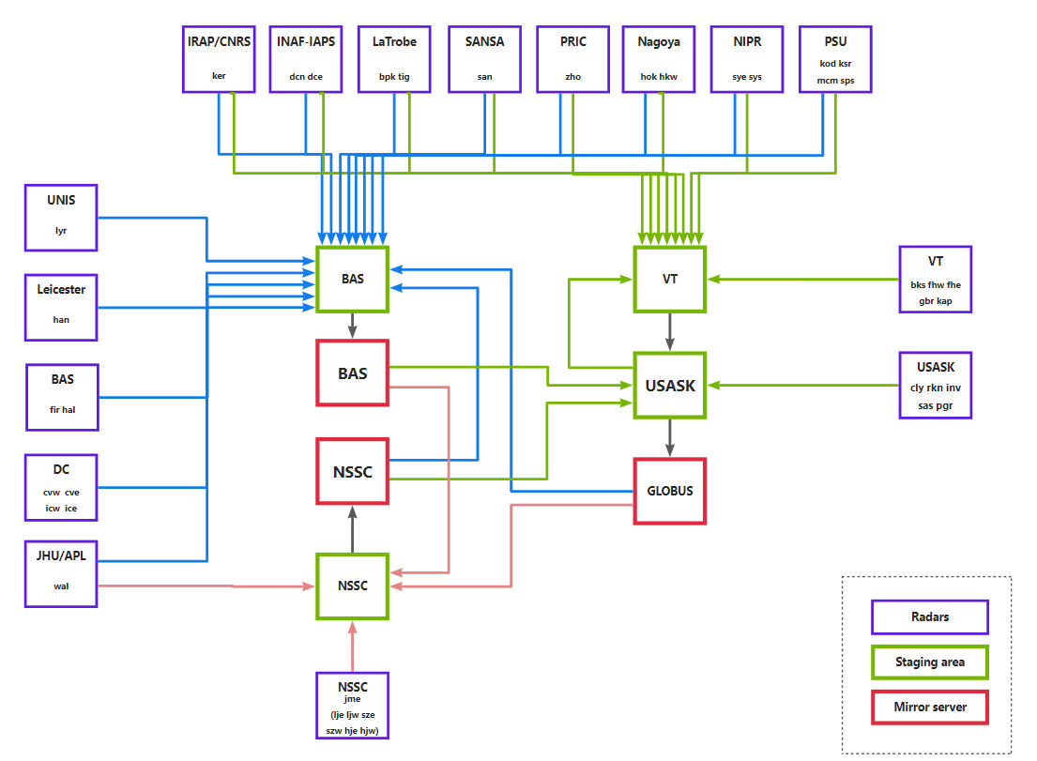
SuperDARN Data Distribution Network
3 Mirrors
40 Radars
23 Active members
6 Observer
GITHUB: https://github.com/SuperDARN/DDWG

Slide 5
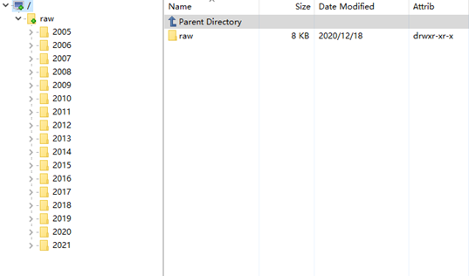
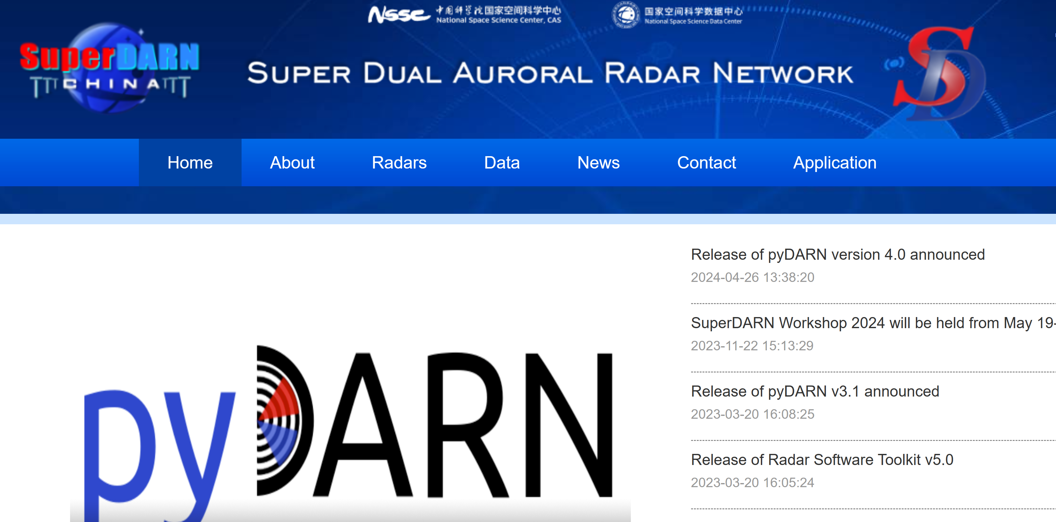
SuperDARN Data Distribution Network
Data Access
USASK
Globus
cedar.computecanada.ca
Contact
Theodore Kolkman
Draven Galeschuk
FTP service
NSSC
Contact
Ma Fuli
He Dabin
WEB service
https://superdarn.nssdc.ac.cn/
External-facing mirror node
BAS
Contact TBC
Data catalogue API https://api.bas.ac.uk/superdarn/mirror/v3/.

Slide 6
02
SuperDARN DDWG Working Summary

Slide 7
Working Summary
An official block list was created.
Based on the list from NSSC,GLOBUS AND BAS in Oct. 2023, and it was made available on the GitHub (DDWG/Blocklist/blocklist_all 20231028.txt).
2. DDWG members updated
We update the list of DDWG members only including those people who're currently contribute to the group, already shared it on the GitHub (DDWG/charter.md)
3. NSSC mirror opened FTP service
NSSC opened new FTP service to the PIs and public users, detailed instruction for accessing the ftp service was shared in GitHub.
4. BAS new mirror service
BAS is in the process of setting up a new mirror server to manage the acquisition of data from institute staging servers, this new server is replacing bslsuperdarna.nerc-bas.ac.uk.

Slide 8
Working Summary
File Updates
There are 21 PGR files from 2006 January 01 that were removed and blocked at three mirrors according to request from Draven Galeschuk.
Files between August and September for cly and rkn, and for sas have a problem when processing these files into fitacf or fitacf3 files.The broken files have been reprocessed and the new fixed files were available on Globus.
Remove 18 error files of wal radar from the mirrors according to the request from Evan.
1421 files from RKN, CLY AND SAS were generated incorrectly by the new computers installed at those sites, old data was removed and new data was uploaded at the mirrors.
13 files with no useful data from icw was removed in Oct. 2023.

Slide 9
Working Summary
Outstanding Tasks
1. Get all 2022 files to be included in FRDR and SuperDARN China Website.
2. SuperCanada made a new end point for the mirror that works with Globus V5.
3. NSSC mirror opened FTP service to SuperDARN users.
4. A new list of DDWG members was released.

Slide 10
03
SuperDARN Data Storage Requirements

Slide 11
SuperDARN Data Volume Trend
Year | Data Volume(TB) per Year
2013 | 3.46
2014 | 4.36
2015 | 4.44
2016 | 3.92
2017 | 3.97
2018 | 3.75
2019 | 2.91
2020 | 4.19
2021 | 3.89
2022 | 4.53
2023 | 5.70

Slide 12
SuperDARN Data Volume Trend
Year | Total Data Volume(TB）
2013 | 18.13
2014 | 22.48
2015 | 26.92
2016 | 30.84
2017 | 34.81
2018 | 38.56
2019 | 41.47
2020 | 45.66
2021 | 49.56
2022 | 54.09
2023 | 59.79
2024 | 65.59
2025 | 71.39
2026 | 77.39
2027 | 83.39
2028 | 89.39
+ 5.8
+ 5.8
+ 6.0
+ 6.0
+ 6.0

Slide 13
SuperDARN radars data rate(GB/year)
 | Radar Code | Start Date | End Date | 2013 | 2014 | 2015 | 2016 | 2017 | 2018 | 2019 | 2020 | 2021 | 2022 | 2023 | 2024 | 2025 | 2026 | 2027 | 2028
1 | ade | 2012-09-08 | 2018-10-16 | 67.53 | 144.54 | 170.20 | 134.35 | 95.74 | 70.27 | 0.00 | 0.00 | 0.00 | 0.00 | 0.00 | 0.00 | 0.00 | 0.00 | 0.00 | 0.00
2 | adw | 2012-09-08 | 2018-10-31 | 74.65 | 143.68 | 162.28 | 145.85 | 120.86 | 91.69 | 0.00 | 0.00 | 0.00 | 0.00 | 0.00 | 0.00 | 0.00 | 0.00 | 0.00 | 0.00
3 | bks | 2008-02-02 | 2022-12-31 | 147.09 | 243.51 | 231.67 | 231.73 | 224.60 | 214.80 | 57.94 | 149.67 | 176.94 | 126.94 | 0.00 | 0.00 | 0.00 | 0.00 | 0.00 | 0.00
4 | bpk | 2014-01-13 | 2024-02-07 | 0.00 | 146.23 | 171.68 | 154.86 | 142.30 | 151.29 | 148.30 | 643.44 | 680.87 | 1240.04 | 1457.82 | 1457.82 | 1457.82 | 1457.82 | 1457.82 | 1457.82
5 | cly | 2013-07-01 | 2024-01-05 | 73.11 | 179.84 | 169.69 | 130.61 | 111.24 | 122.92 | 124.30 | 252.39 | 259.19 | 183.81 | 250.20 | 1800.00 | 1800.00 | 1800.00 | 1800.00 | 1800.00
6 | cve | 2010-12-02 | 2024-02-15 | 217.35 | 218.24 | 199.06 | 186.28 | 172.80 | 159.09 | 158.20 | 165.09 | 160.38 | 188.91 | 200.98 | 1200.00 | 1200.00 | 1200.00 | 1200.00 | 1200.00
7 | cvw | 2010-12-02 | 2024-02-15 | 214.15 | 207.11 | 183.90 | 192.06 | 176.15 | 176.68 | 168.47 | 176.86 | 166.70 | 196.78 | 218.09 | 1200.00 | 1200.00 | 1200.00 | 1200.00 | 1200.00
8 | dce | 2013-01-23 | 2023-12-02 | 137.12 | 147.33 | 73.46 | 80.78 | 75.65 | 34.73 | 34.21 | 53.00 | 107.07 | 120.10 | 82.37 | 114.75 | 114.75 | 114.75 | 114.75 | 114.75
9 | dcn | 2019-01-29 | 2023-12-02 | 0.00 | 0.00 | 0.00 | 0.00 | 0.00 | 0.00 | 31.16 | 27.80 | 64.45 | 56.36 | 91.42 | 127.37 | 127.37 | 127.37 | 127.37 | 127.37
10 | fhe | 2010-01-01 | 2024-02-17 | 84.29 | 93.47 | 97.16 | 105.43 | 105.10 | 86.85 | 104.62 | 103.22 | 98.00 | 78.72 | 123.20 | 123.20 | 123.20 | 123.20 | 123.20 | 123.20
11 | fhw | 2010-02-16 | 2024-02-17 | 82.56 | 100.08 | 102.32 | 110.90 | 108.46 | 87.49 | 104.40 | 99.35 | 94.04 | 75.78 | 113.73 | 113.73 | 113.73 | 113.73 | 113.73 | 113.73
12 | fir | 2010-02-14 | 2024-02-17 | 0.00 | 0.00 | 0.00 | 0.00 | 27.01 | 93.71 | 108.05 | 215.55 | 252.18 | 243.14 | 395.46 | 395.46 | 395.46 | 395.46 | 395.46 | 395.46
13 | gbr | 2006-07-01 | 2024-02-17 | 37.48 | 63.56 | 16.98 | 12.63 | 11.54 | 12.68 | 29.06 | 50.62 | 41.21 | 37.10 | 63.29 | 63.29 | 63.29 | 63.29 | 63.29 | 63.29
14 | hal | 2006-07-01 | 2016-01-19 | 115.48 | 71.00 | 99.28 | 1.22 | 0.00 | 0.00 | 0.00 | 0.00 | 0.00 | 0.00 | 0.00 | 0.00 | 0.00 | 0.00 | 0.00 | 0.00
15 | han | 2006-07-01 | 2019-07-19 | 220.10 | 202.18 | 188.30 | 165.74 | 151.86 | 153.82 | 51.75 | 0.00 | 0.00 | 0.00 | 0.00 | 0.00 | 0.00 | 0.00 | 0.00 | 0.00
16 | hkw | 2014-10-29 | 2024-02-16 |  | 29.36 | 129.68 | 155.23 | 145.85 | 141.95 | 160.38 | 163.85 | 171.01 | 211.43 | 272.95 | 272.95 | 272.95 | 272.95 | 272.95 | 272.95
17 | hok | 2007-12-11 | 2024-02-16 | 186.38 | 188.98 | 160.65 | 158.37 | 162.77 | 147.47 | 158.11 | 162.13 | 159.17 | 168.69 | 172.95 | 172.95 | 172.95 | 172.95 | 172.95 | 172.95
18 | ice | 2023-01-24 | 2024-02-17 | 0.00 | 0.00 | 0.00 | 0.00 | 0.00 | 0.00 | 0.00 | 0.00 | 0.00 | 0.00 | 168.90 | 1200.00 | 1200.00 | 1200.00 | 1200.00 | 1200.00
19 | icw | 2023-01-24 | 2024-02-17 | 0.00 | 0.00 | 0.00 | 0.00 | 0.00 | 0.00 | 0.00 | 0.00 | 0.00 | 0.00 | 155.98 | 1200.00 | 1200.00 | 1200.00 | 1200.00 | 1200.00
20 | inv | 2007-10-25 | 2024-01-05 | 153.29 | 178.49 | 180.48 | 155.06 | 137.13 | 150.44 | 187.13 | 179.84 | 197.78 | 198.22 | 249.47 | 1800.00 | 1800.00 | 1800.00 | 1800.00 | 1800.00

Slide 14
SuperDARN radars data rate (GB/year)
 | Radar Code | Start Date | End Date | 2013 | 2014 | 2015 | 2016 | 2017 | 2018 | 2019 | 2020 | 2021 | 2022 | 2023 | 2024 | 2025 | 2026 | 2027 | 2028
21 | jme | 2019-06-25 | 2024-02-01 | 0.00 | 0.00 | 0.00 | 0.00 | 0.00 | 0.00 | 60.38 | 357.97 | 167.18 | 162.06 | 176.00 | 176.00 | 176.00 | 176.00 | 176.00 | 176.00
22 | kap | 2006-07-01 | 2024-02-17 | 52.02 | 71.97 | 67.56 | 53.24 | 40.12 | 83.72 | 167.64 | 168.48 | 34.02 | 79.52 | 184.60 | 184.60 | 184.60 | 184.60 | 184.60 | 184.60
23 | ker | 2006-08-18 | 2019-11-25 | 93.00 | 100.81 | 100.28 | 98.64 | 91.17 | 88.72 | 80.15 | 0.00 | 0.00 | 0.00 | 0.00 | 0.00 | 0.00 | 0.00 | 0.00 | 0.00
24 | kod | 2006-07-01 | 2024-02-15 | 174.69 | 379.62 | 187.35 | 115.54 | 257.91 | 216.44 | 150.09 | 117.75 | 100.65 | 122.75 | 140.07 | 140.07 | 140.07 | 140.07 | 140.07 | 140.07
25 | ksr | 2006-07-01 | 2024-02-15 | 138.30 | 201.11 | 208.58 | 205.30 | 134.24 | 158.07 | 68.12 | 164.98 | 54.58 | 33.78 | 103.87 | 103.87 | 103.87 | 103.87 | 103.87 | 103.87
26 | lyr | 2016-10-19 | 2018-10-23 | 0.00 | 0.00 | 0.00 | 34.53 | 192.05 | 155.04 | 0.00 | 0.00 | 0.00 | 0.00 | 0.00 | 290.00 | 290.00 | 290.00 | 290.00 | 290.00
27 | mcm | 2010-01-22 | 2024-02-16 | 115.67 | 125.59 | 320.21 | 256.85 | 219.80 | 114.75 | 103.19 | 92.36 | 112.50 | 124.76 | 131.62 | 131.62 | 131.62 | 131.62 | 131.62 | 131.62
28 | pgr | 2006-01-01 | 2024-01-05 | 136.15 | 141.37 | 133.89 | 116.40 | 94.40 | 108.15 | 142.40 | 197.13 | 202.97 | 192.73 | 224.06 | 1800.00 | 1800.00 | 1800.00 | 1800.00 | 1800.00
29 | pyk | 2006-07-01 | 2018-09-08 | 172.12 | 176.51 | 185.07 | 72.69 | 112.39 | 36.99 | 0.00 | 0.00 | 0.00 | 0.00 | 0.00 | 0.00 | 0.00 | 0.00 | 0.00 | 0.00
30 | rkn | 2006-07-01 | 2024-01-04 | 105.36 | 140.45 | 104.98 | 106.55 | 101.17 | 108.15 | 125.64 | 155.08 | 132.85 | 199.36 | 260.54 | 1800.00 | 1800.00 | 1800.00 | 1800.00 | 1800.00
31 | san | 2007-01-01 | 2024-01-23 | 28.78 | 10.43 | 23.86 | 29.82 | 38.85 | 39.05 | 39.39 | 37.67 | 36.72 | 37.30 | 37.43 | 584.00 | 584.00 | 584.00 | 584.00 | 584.00
32 | sas | 2006-07-01 | 2024-01-05 | 134.18 | 141.52 | 133.12 | 101.87 | 96.93 | 104.67 | 82.03 | 197.66 | 192.61 | 202.44 | 216.52 | 1800.00 | 1800.00 | 1800.00 | 1800.00 | 1800.00
33 | sps | 2013-01-21 | 2024-02-16 | 77.45 | 163.56 | 161.76 | 144.39 | 140.57 | 125.00 | 51.28 | 129.11 | 143.57 | 153.45 | 158.50 | 158.50 | 158.50 | 158.50 | 158.50 | 158.50
34 | sto | 2006-07-01 | 2019-03-21 | 47.34 | 58.70 | 48.45 | 55.66 | 44.84 | 21.37 | 7.09 | 0.00 | 0.00 | 0.00 | 0.00 | 0.00 | 0.00 | 0.00 | 0.00 | 0.00
35 | sye | 2006-07-01 | 2021-12-11 | 47.81 | 24.26 | 30.99 | 27.95 | 11.93 | 4.18 | 1.04 | 0.61 | 0.60 | 0.00 | 0.00 | 0.00 | 0.00 | 0.00 | 0.00 | 0.00
36 | sys | 2007-04-14 | 2022-08-29 | 59.82 | 75.85 | 146.51 | 10.19 | 87.91 | 155.12 | 9.79 | 56.29 | 0.00 | 56.29 | 0.00 | 0.00 | 0.00 | 0.00 | 0.00 | 0.00
37 | tig | 2006-07-01 | 2020-03-24 | 93.76 | 83.86 | 126.95 | 83.78 | 73.09 | 139.87 | 32.71 | 40.13 | 0.00 | 0.00 | 0.00 | 0.00 | 0.00 | 0.00 | 0.00 | 0.00
38 | unw | 2006-07-01 | 2019-07-25 | 56.62 | 5.33 | 16.98 | 171.13 | 158.80 | 104.17 | 49.23 | 0.00 | 0.00 | 0.00 | 0.00 | 0.00 | 0.00 | 0.00 | 0.00 | 0.00
39 | wal | 2005-06-10 | 2024-02-18 | 21.19 | 19.16 | 19.15 | 17.37 | 13.19 |  | 2.13 | 5.06 | 4.12 | 55.06 | 187.35 | 300.00 | 300.00 | 300.00 | 300.00 | 300.00
40 | zho | 2010-04-03 | 2022-06-30 | 175.71 | 184.82 | 190.48 | 186.36 | 188.73 | 185.13 | 184.05 | 184.03 | 172.67 | 94.05 | 0.00 | 0.00 | 0.00 | 0.00 | 0.00 | 0.00

Slide 15
SuperDARN Data Volume New Trend based on new data requirements
The yellow pillars show the current status and the trend analysis is based on the current radars data rate.
The Green pillars show the new data volume trend analysis after collecting new radar data requirements, currently we got new data rate requirements as follows:
CV and IC radars data rate increase to 1.2TB/year/radar
NSSC 6 new radars, each radar generate about 500GB/year.
SAN radars data rate increase to 1.6 GB/day，584GB/year.
SAS, PGR, RKN, INV, and CLY radars data rate increase to 1.8TB/year/radar.
LYR will come back, 290GB/year.

Slide 16
04
SuperDARN DDWG Future Topics

Slide 17
SuperDARN DDWG Future Topics
1. Research the data checking with pydarnio, what is being checked.
2. Collate and make available information about how each mirror checks files
3. Discuss and decide upon policy for using mirrors to distribute SND files (sounding files)
4. Discuss SuperDARN data volume trend analysis and finalize the report, more storage/efficient processing will be required.
5. Finalize file checking policy with DDWG members
6. Finalize policy for what records to keep at mirrors
7. Finalize policy when adding older files to the mirrors
8. Plans to synchronize the mirrors and to keep them synchronized

Slide 18
Thanks

